Slide 1



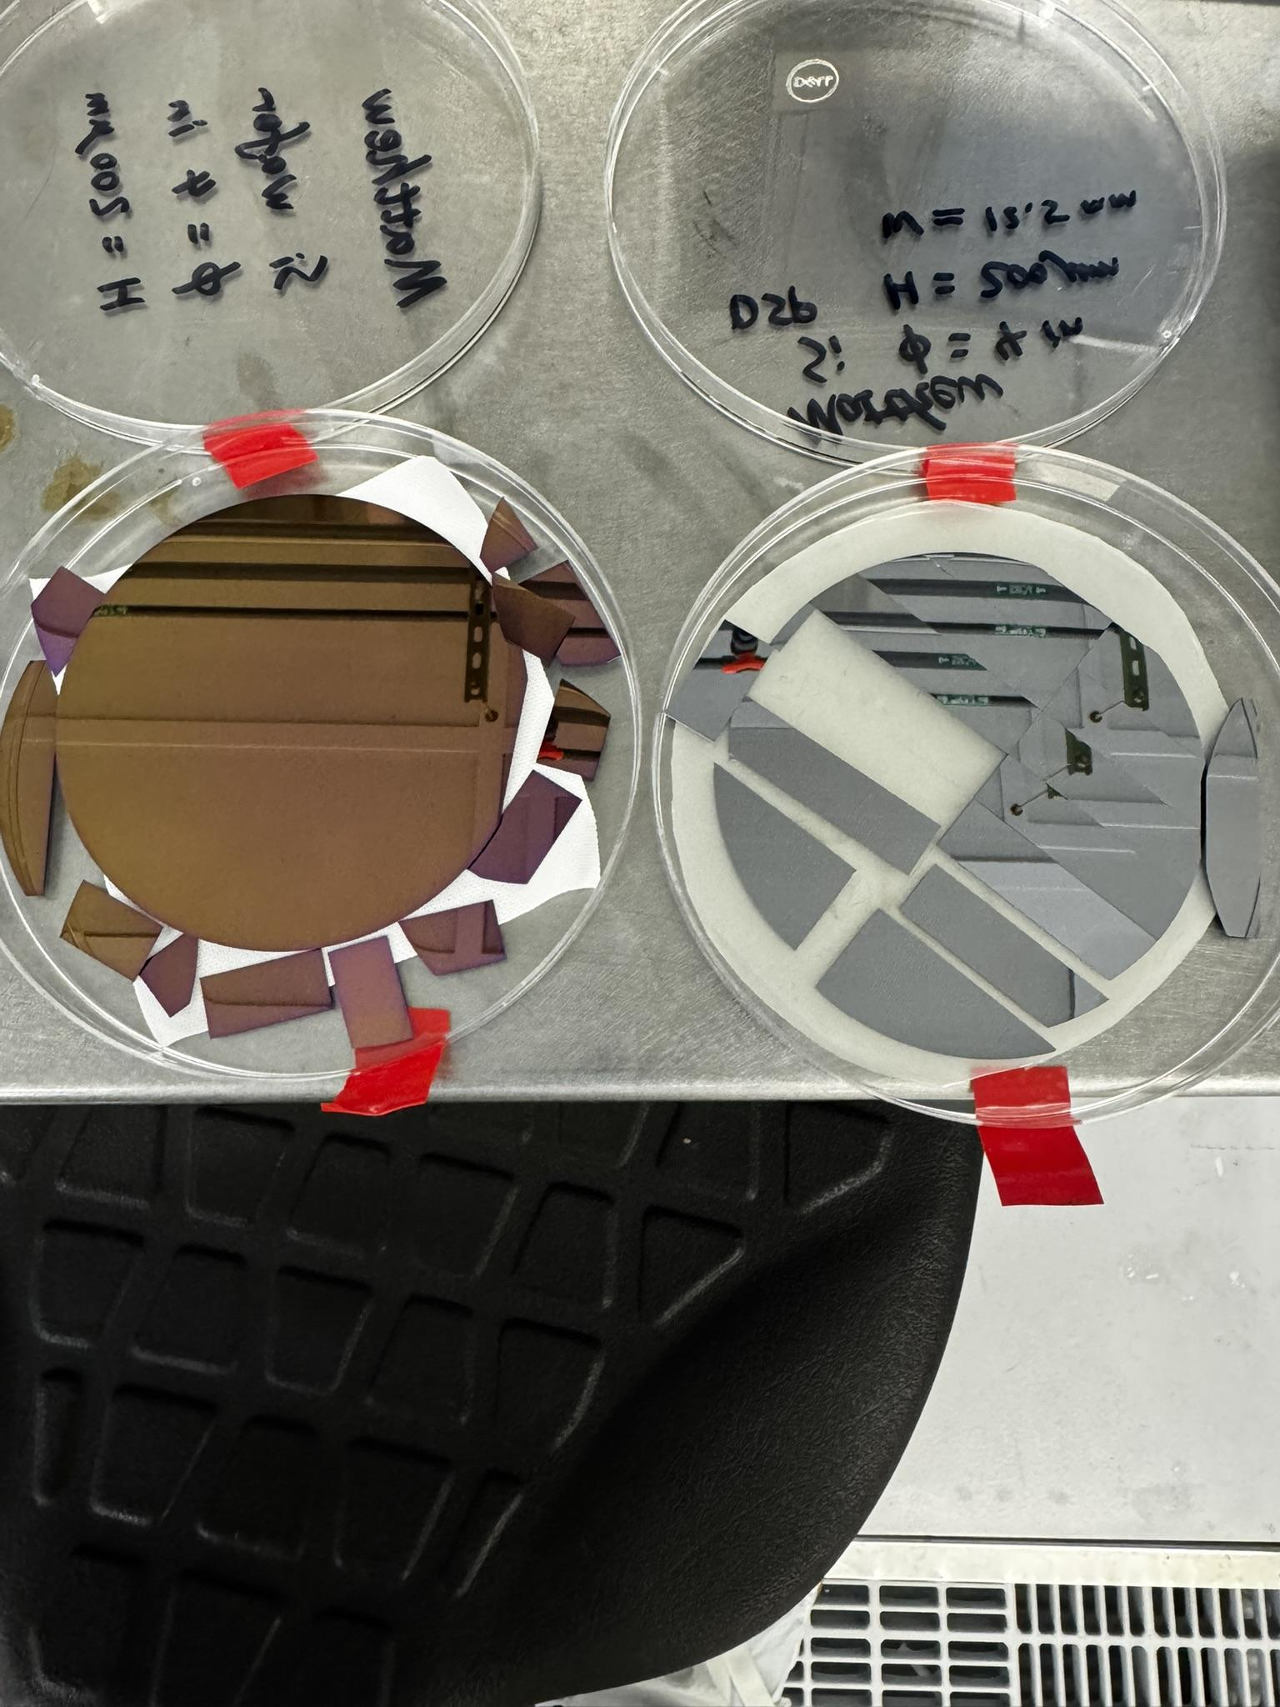
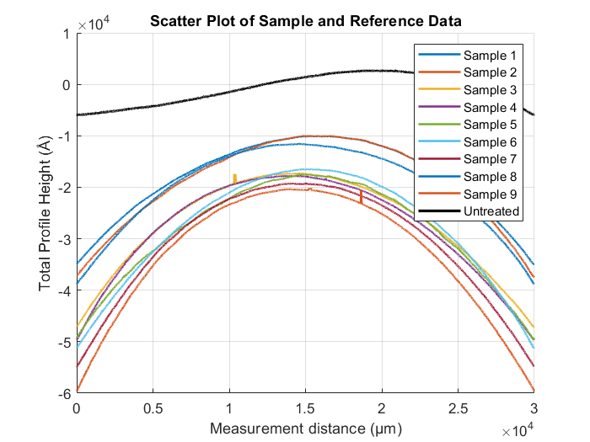
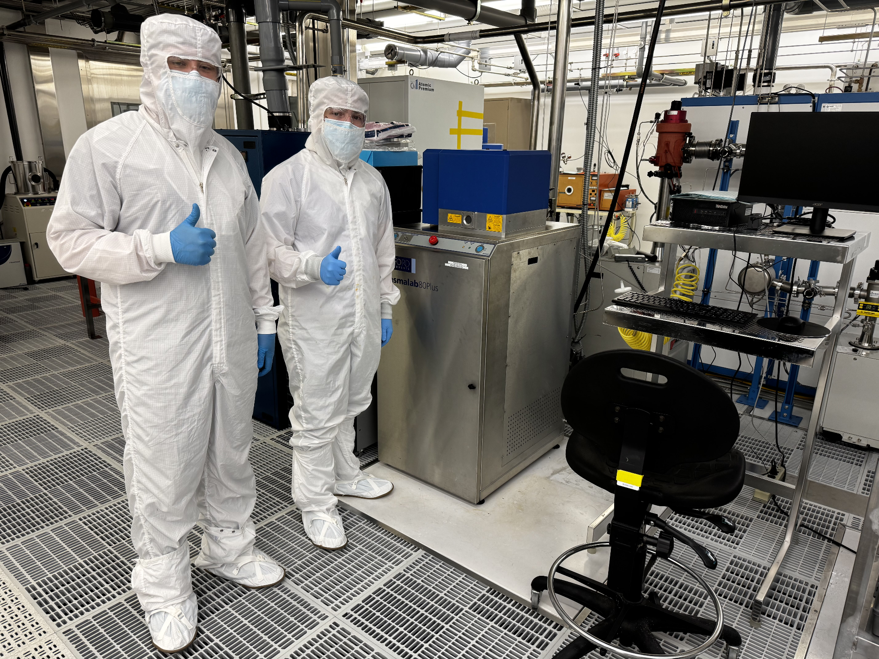
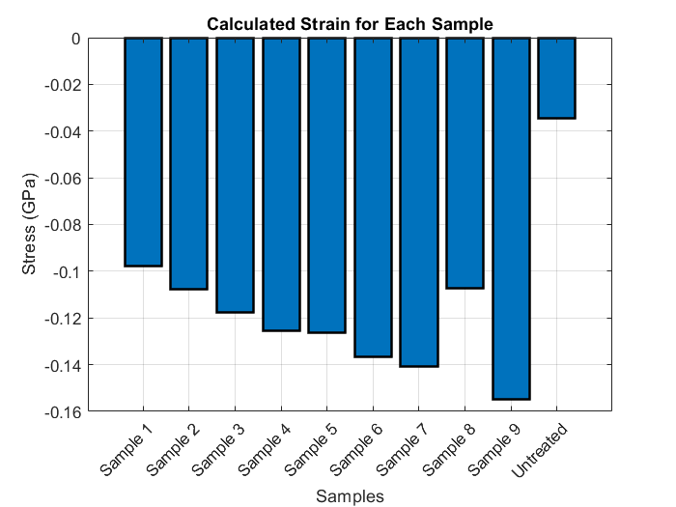
Residual Stresses in Deposited Thin-Film Material Layers for IC Manufacturing
Henry Baxter, Dennis Binford, Gavin Cervantez, Matthew Heilig Advisor: Dr. Jun Zou
Department of Electrical
& Computer Engineering
MOTIVATION
Residual stress widely exists in the thin-film material (metal, semiconductor and dielectric) layers used in IC manufacturing.
The residual stress can significantly impact the device device behavior, performance, reliability and manufacturability.
Fast and accurate characterization of residual stress is critical for the stress control and optimization of the fabrication process.
HYPOTHESIS
Residual stress is contributed by a large number of factors, which can be either compressive or tensile.
When deposited on one side, the residual stress in the thin film can cause bending or warpage of the supporting substrate.
The overall residual stress and its spatial distribution can be characterized by the local curvature of the substrate.
RESULTS
Substrate: 200-μm {100} single-crystal silicon wafer
Deposited thin film: 200-nm SiO₂ with PECVD
Wafer curvature measurement: Bruker DektakⓇ Surface Profiler
DISCUSSIONS
Average stress level: -123.8 MPa
Standard Deviation of 0.0183 MPa
Negative stress means the deposited film is under compression, which makes the substrate buckle up.
Some variation between the parts of the wafer, but still fairly closely grouped across the surface of the wafer sample.
T_{f}- Residual Stress
h_{f}-Film thickness
R- Radius of curve
E_{s}- Substrate Young's Modulus
h_{s}- Substrate thickness
v_{s}- Poisson ratio of 100 Si crystal
CONCLUSIONS
Wafer curvature measurements under a surface profiler can serve as an quick and effective way for non-destructive evaluation of residual stress in thin films.
This method can be expanded for the investigation of different deposition conditions and different materials.
ACKNOWLEDGEMENT
We thank Samsung Austin Semiconductor for providing funding support for the fellowship and cleanroom access and also AggieFab Nanofabrication Facility staff for technical support in equipment training and usage.

